Slide 1
Image Stitching

Slide 2
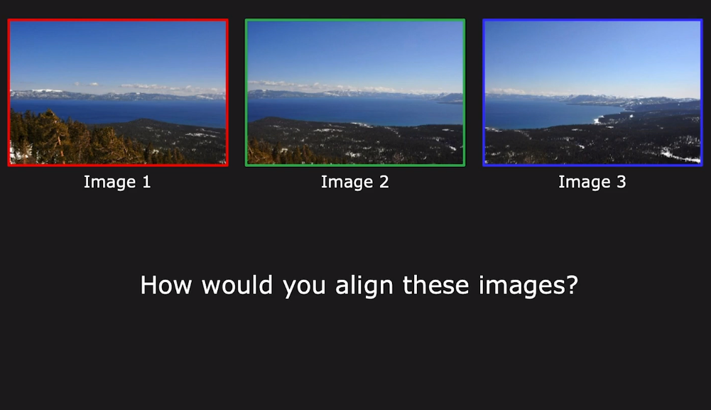
Image Stitching

Slide 3
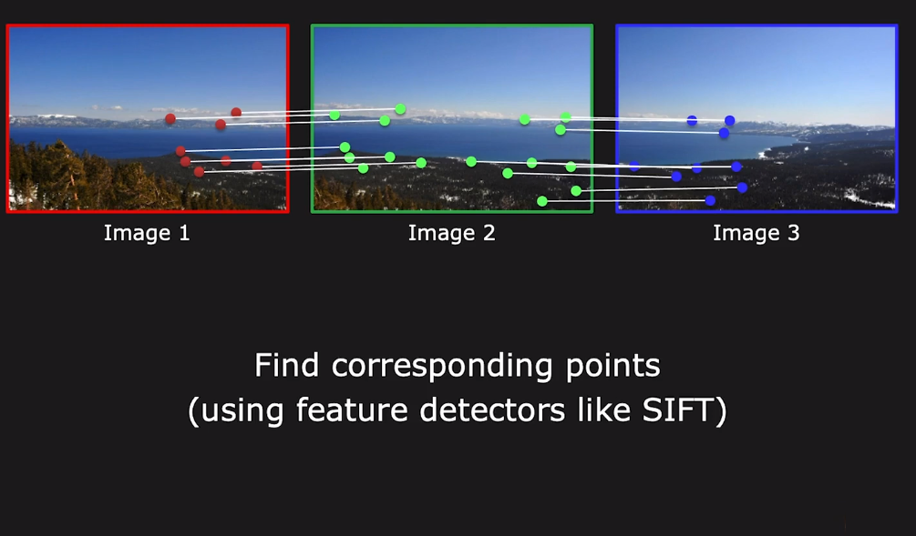
Image Stitching

Slide 4
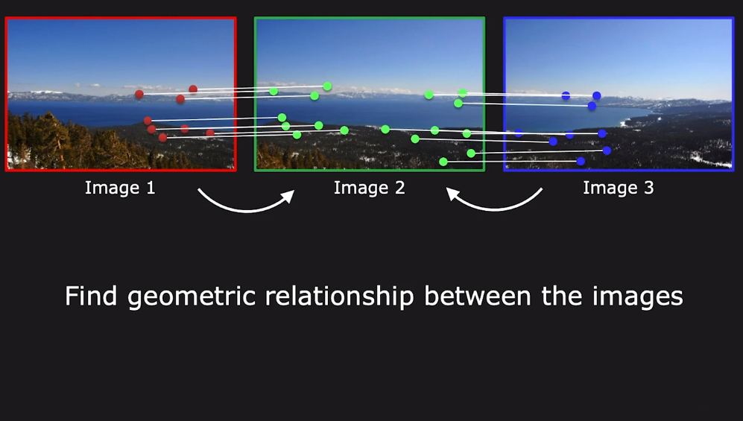
Image Stitching

Slide 5
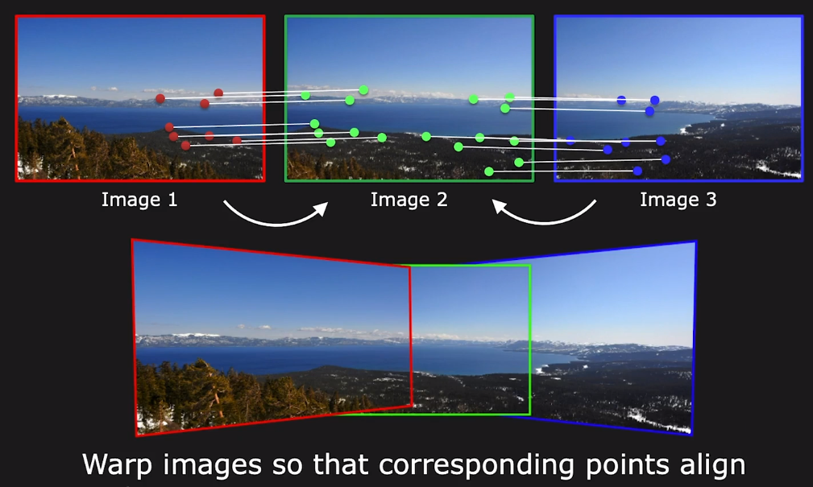
Image Stitching

Slide 6
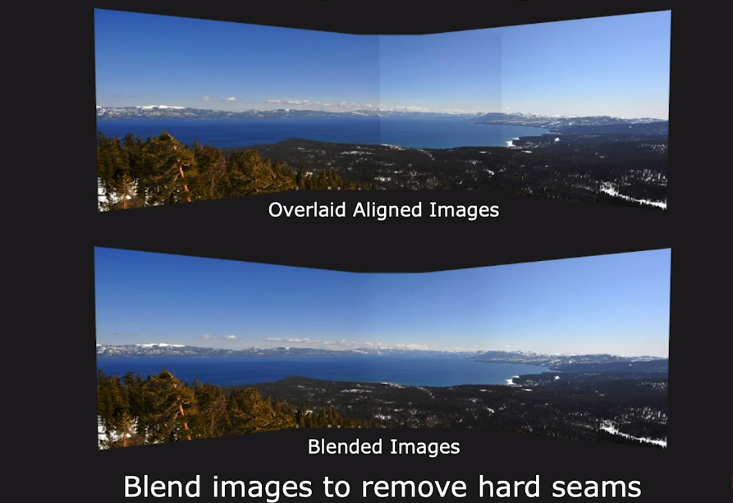
Image Stitching

Slide 7
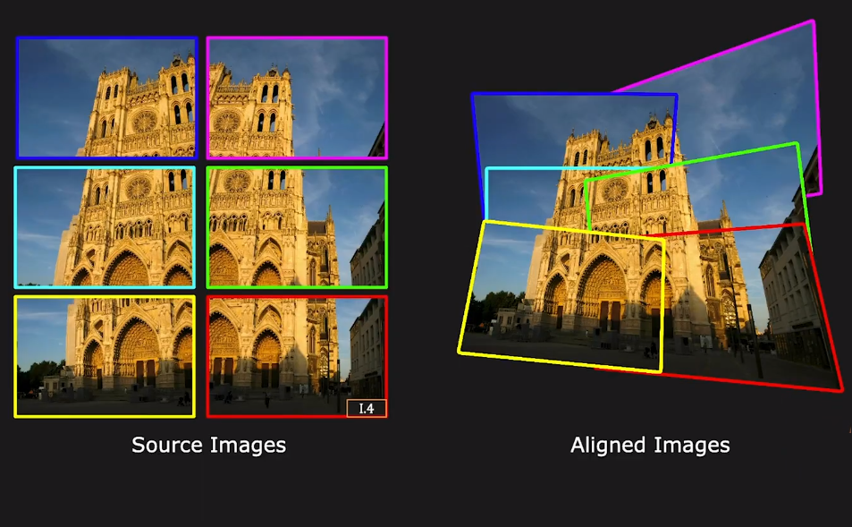
Image Stitching Issues: 1. Alignment

Slide 8
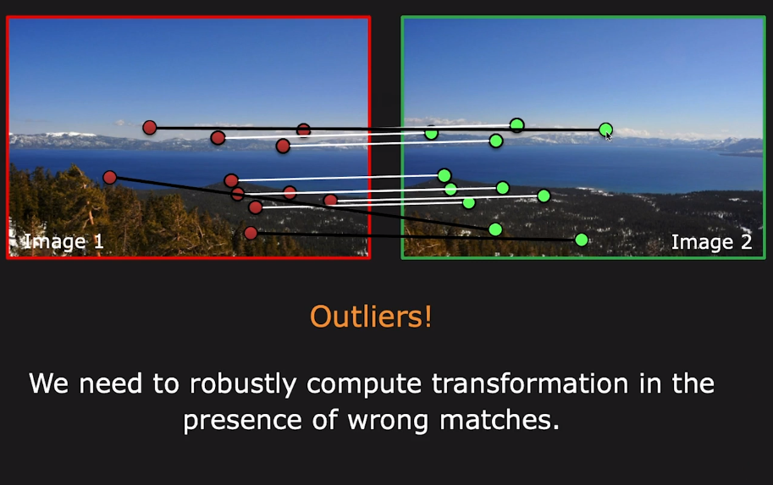
Image Stitching: 2. Correct Matching

Slide 9
Image Stitching: 3. Seamless Blending

Slide 10
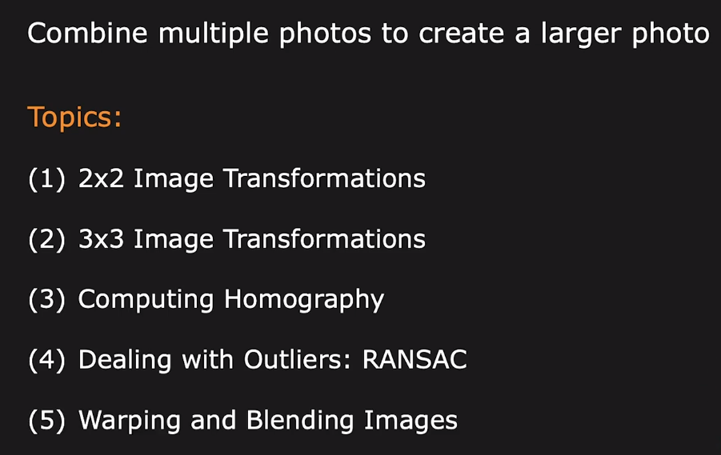
Image Stitching

Slide 11
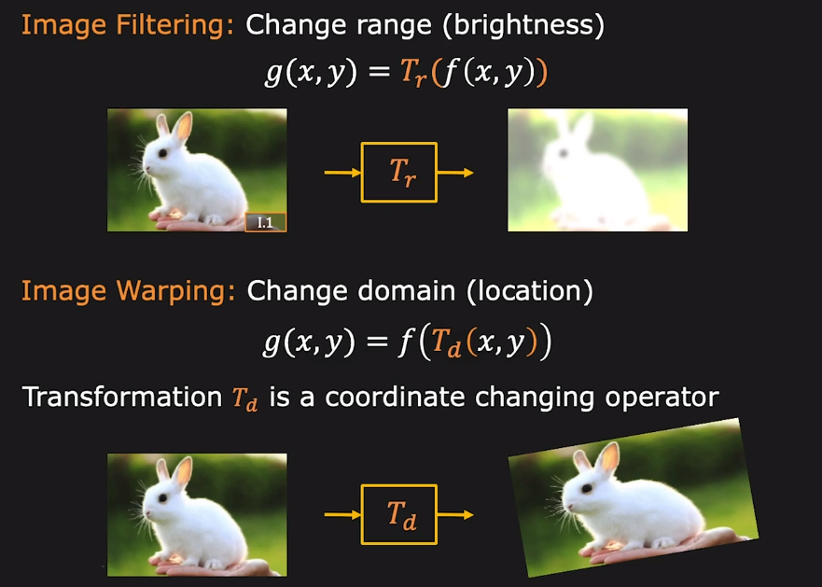
2D Image Manipulation

Slide 12
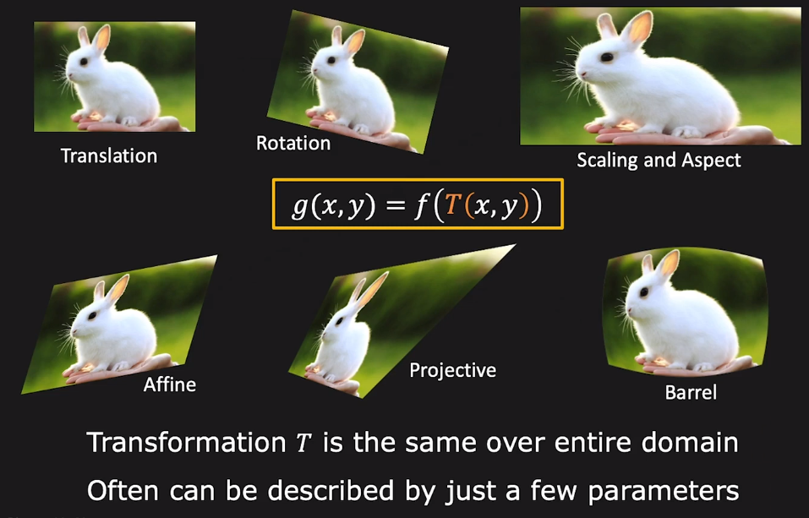
Global Warping/ Transformation

Slide 13
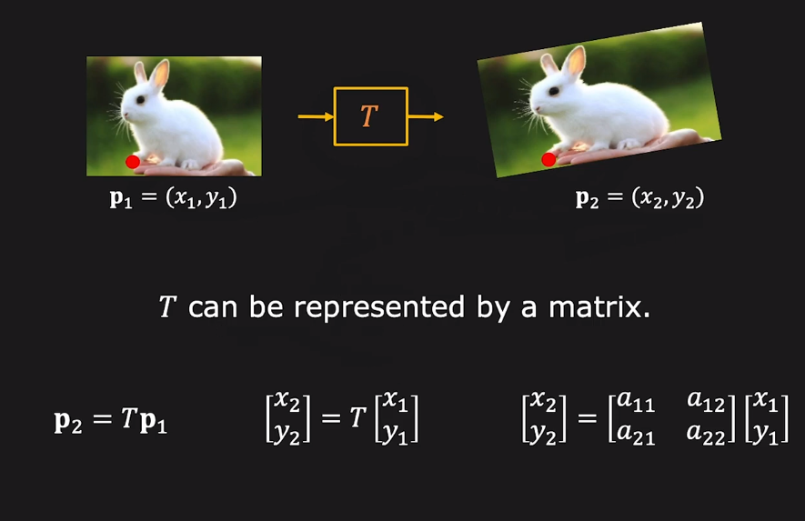
2×2 Linear Transformation

Slide 14
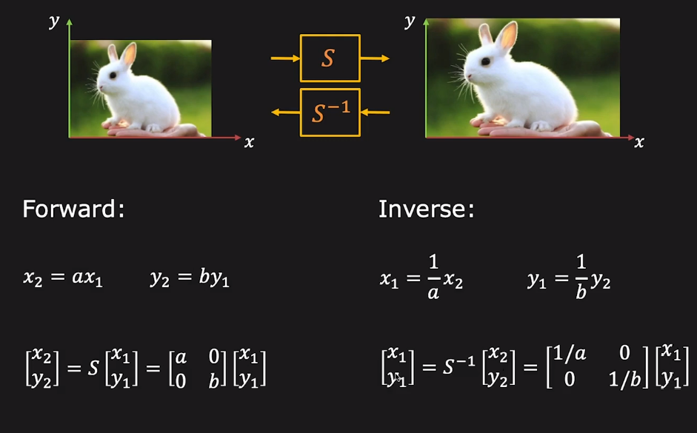
Scaling (Stretching or squishing)

Slide 15
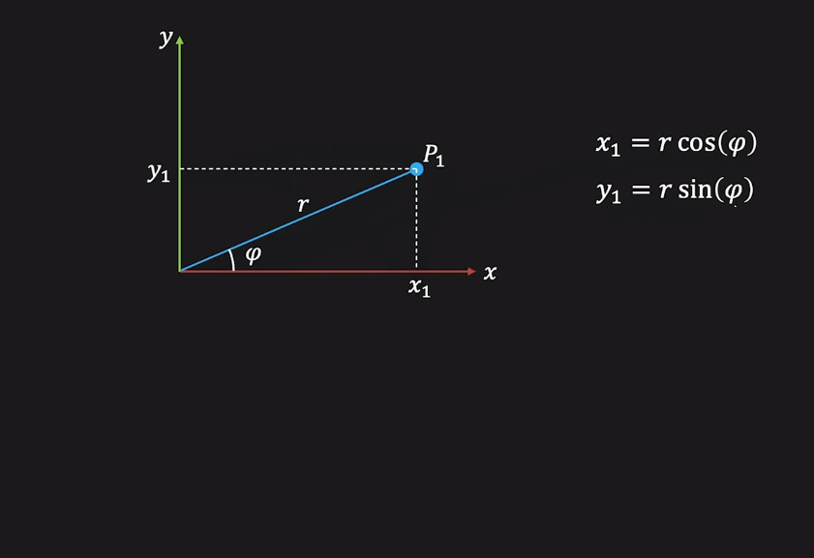
2D Rotation

Slide 16
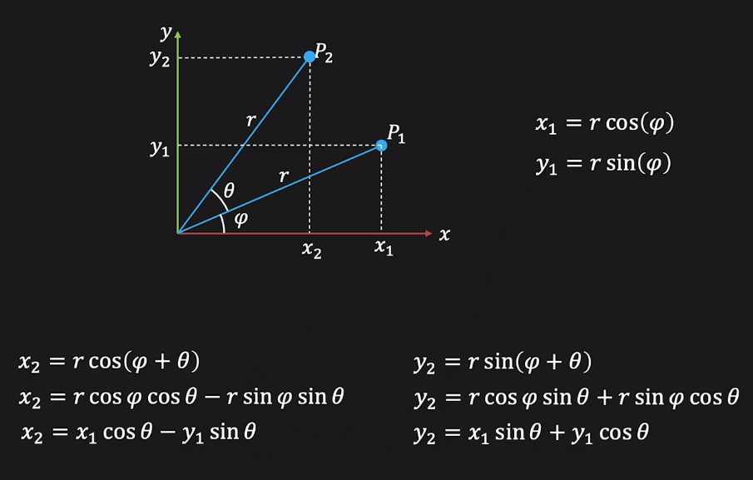
2D Rotation

Slide 17
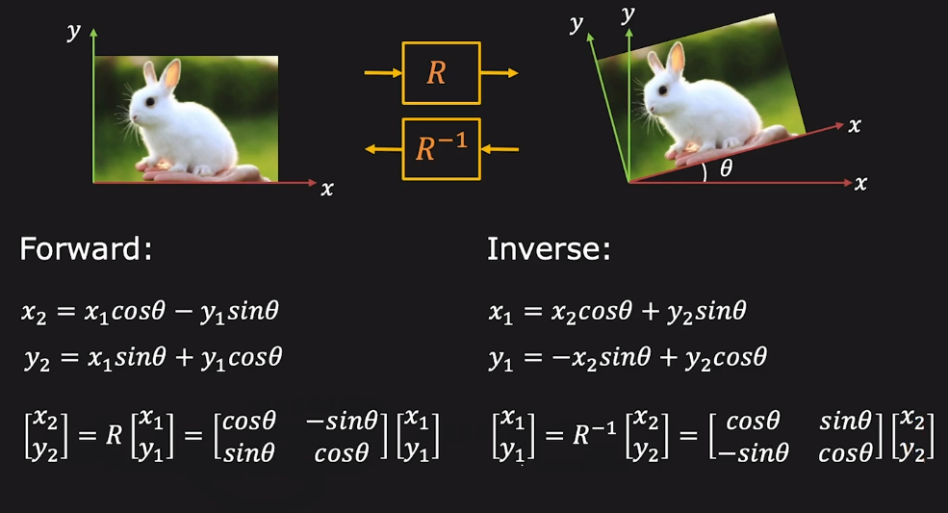
2D Rotation

Slide 18
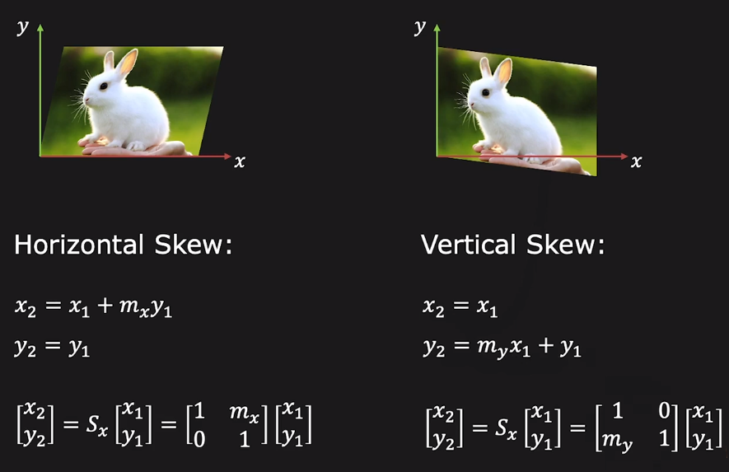
Skew

Slide 19
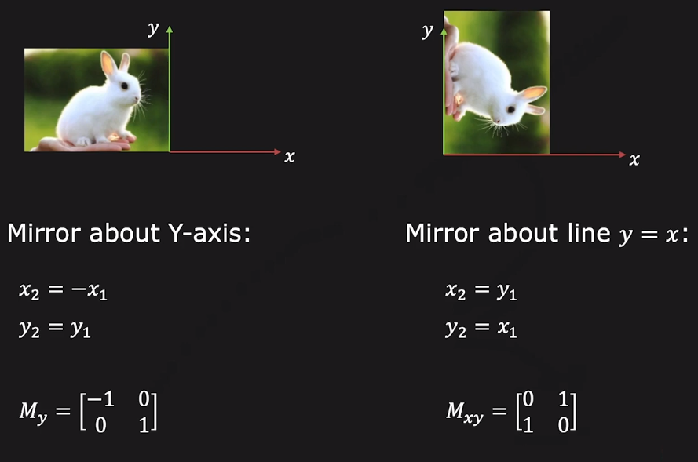
Mirror

Slide 20
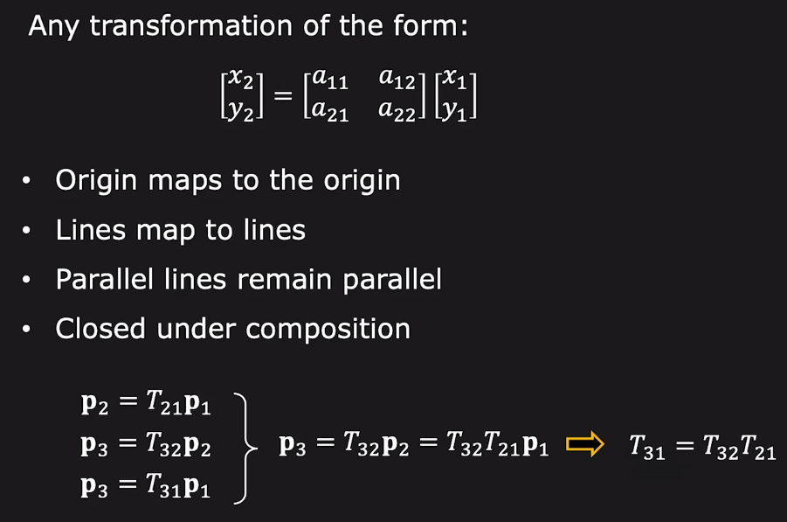
2×2 Matrix Transformations

Slide 21
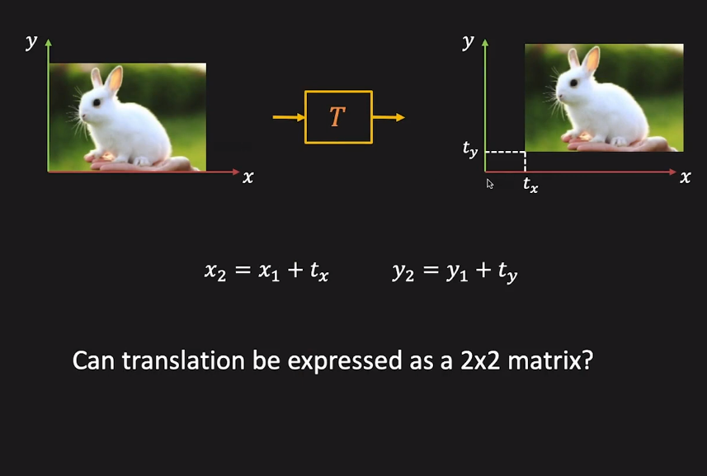
Translation

Slide 22
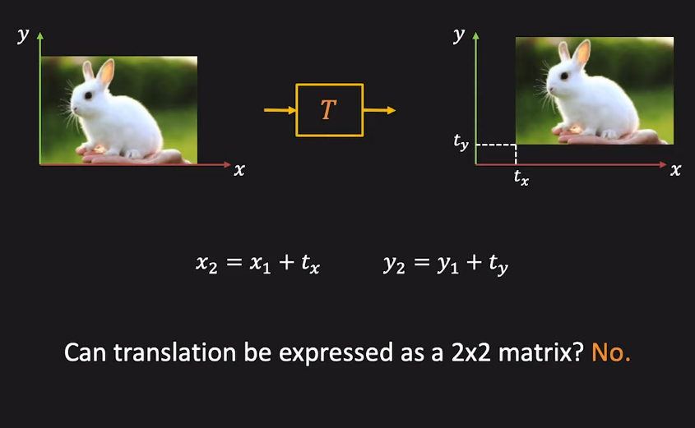
Translation

Slide 23
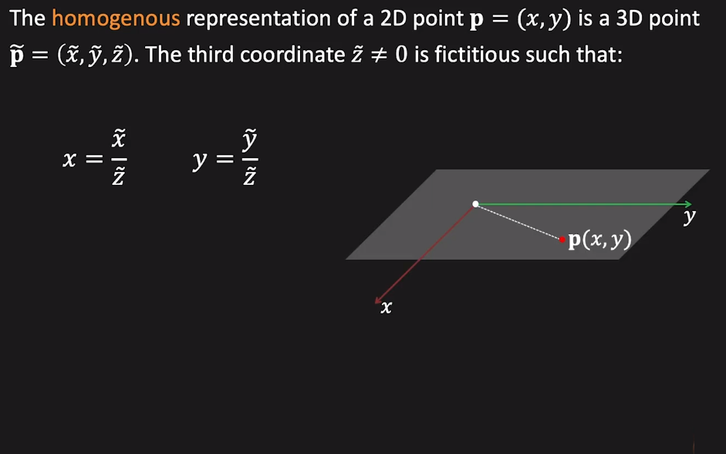
Homogenous Coordinates

Slide 24
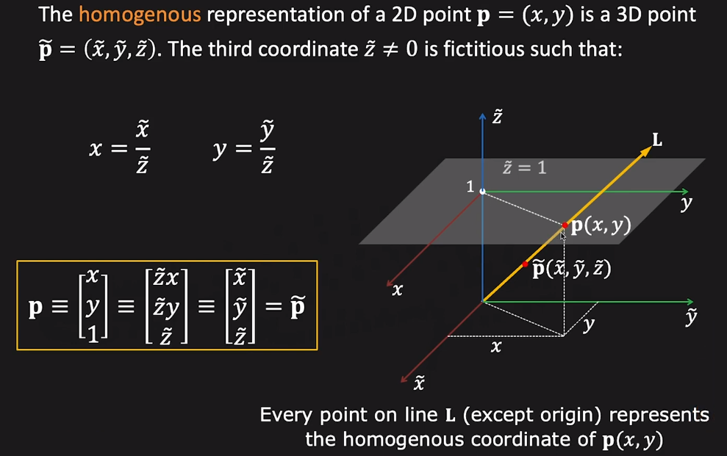
Homogenous Coordinates

Slide 25
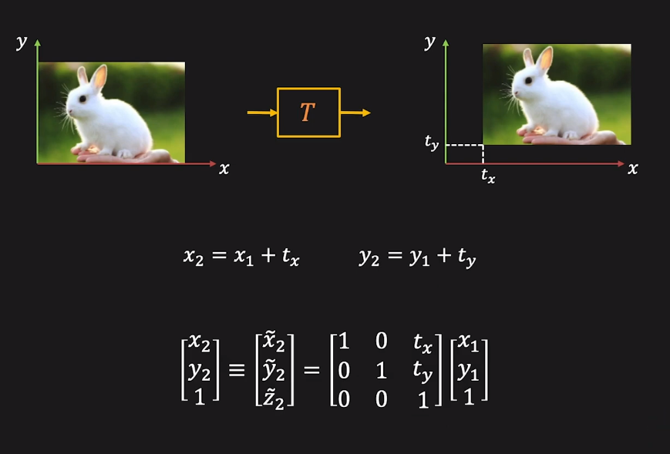
Translation

Slide 26
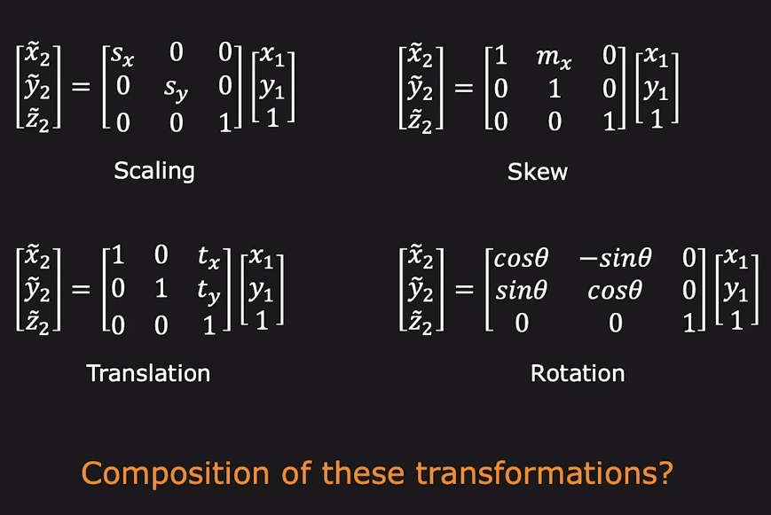
Scaling, Rotation, Skew, Translation

Slide 27
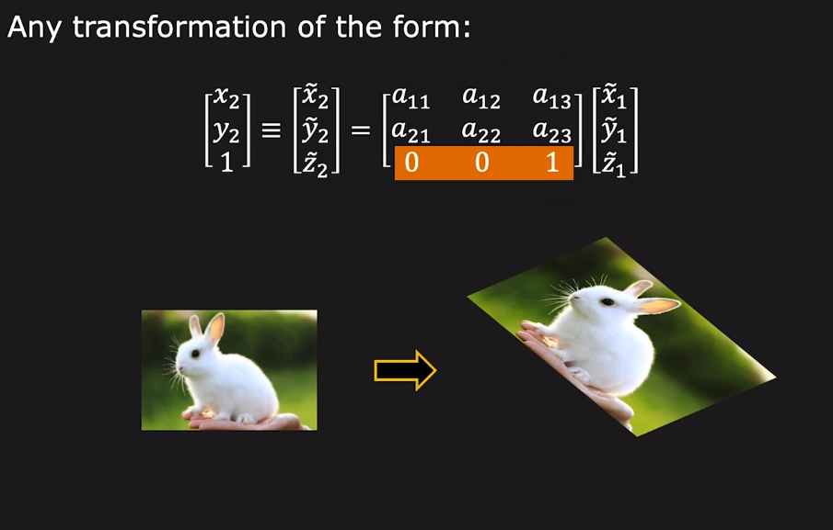
Affine Transformation

Slide 28
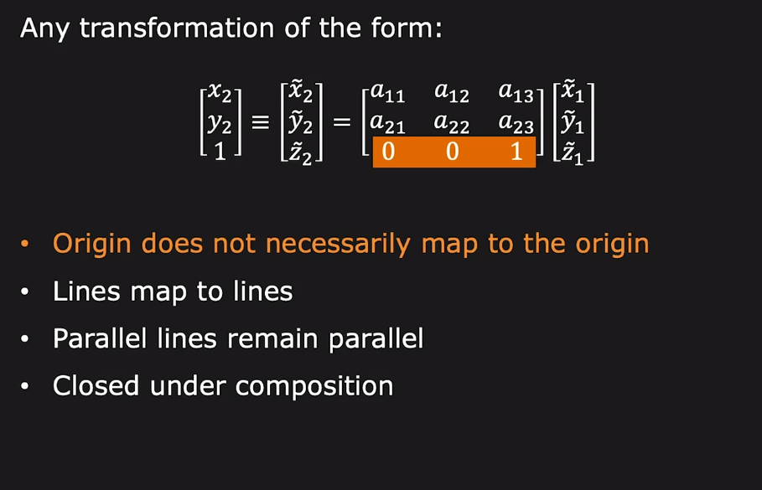
Affine Transformation

Slide 29
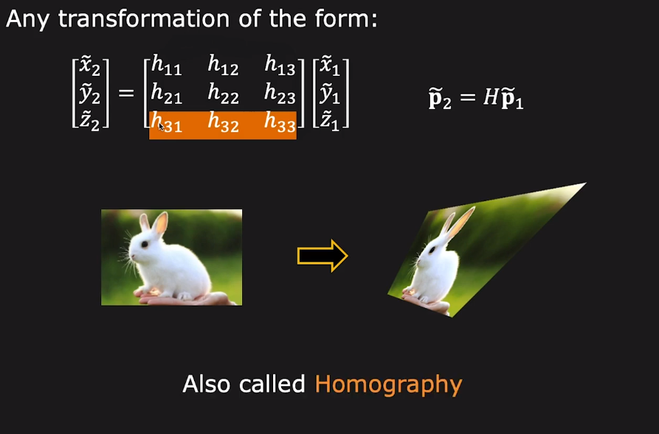
Projective Transformation

Slide 30
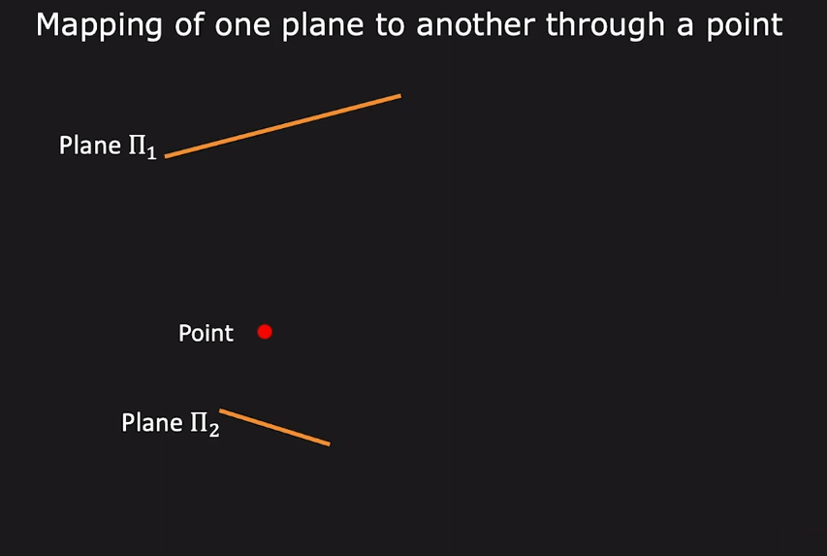
Projective Transformation

Slide 31
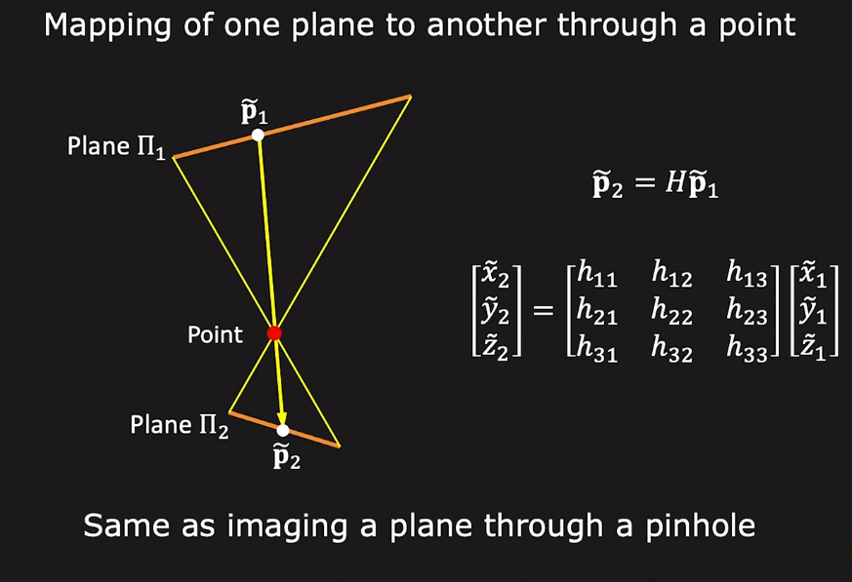
Projective Transformation

Slide 32
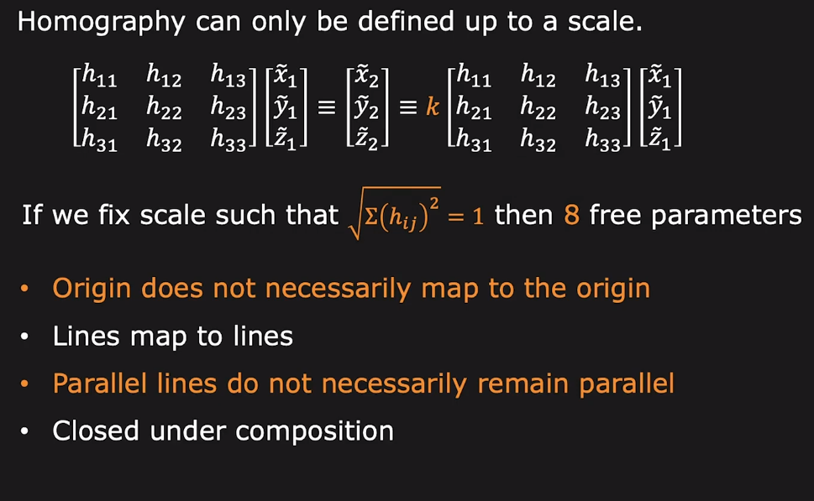
Projective Transformation

Slide 33
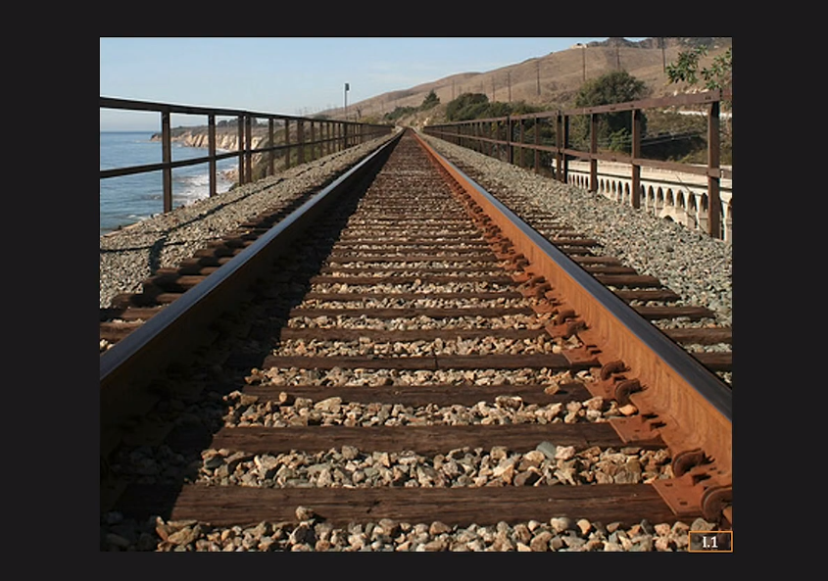
Projective Transformation: Vanishing Point

Slide 34
Thanks

